Slide 1
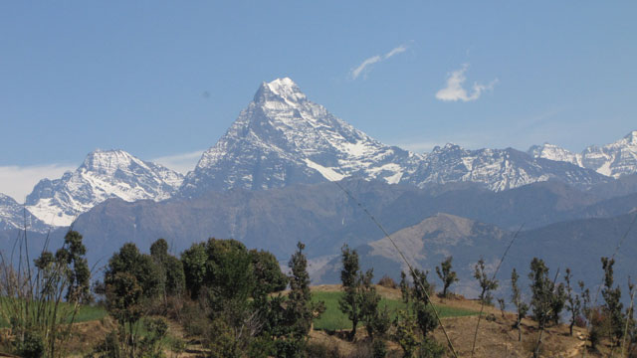



Good Morning

Slide 2
FOSTERING KNOWLEDGE ON DISASTER
Disaster Preparedness Network-Nepal
23rd September 2021

Slide 3
Key area of Presentation
Introduction
Working modality
Focus Areas and Actions
Lesson Learned
Key Issues and Challenges

Slide 4
Introduction
DPNet Nepal established in 1996, has unique relation with Government of Nepal especially with Ministry of Home Affairs to bridge the gap between governmental and non-governmental agencies.
DPNet Nepal facilitate to bring all the governmental and non-governmental institutions in a single umbrella to address the disaster related issues in Nepal.
It’s a Secretariat of National Platform for DRR chaired by the Chief Executive of National Disaster Risk Reduction and Management Authority.
It’s also a Country Focal point for Sphere in Nepal.

Slide 5
Members
Agencies | Number
NGOs | 62
INGOs | 31
UN Agencies | 2
Academia | 3
Total No. of Members | 98

Slide 6
Institutional Structure
Executive Committee
Advisory Committee
Finance
Program
Secretariat
IA and M & E
General Assembly
.

Slide 7
Working Modality
Government of Nepal
Knowledge Management
Policy Advocacy
DPNet-Nepal
I/NGOs
UN Agencies
Corporate Sector
Capacity building
Coordination & Networking

Slide 8
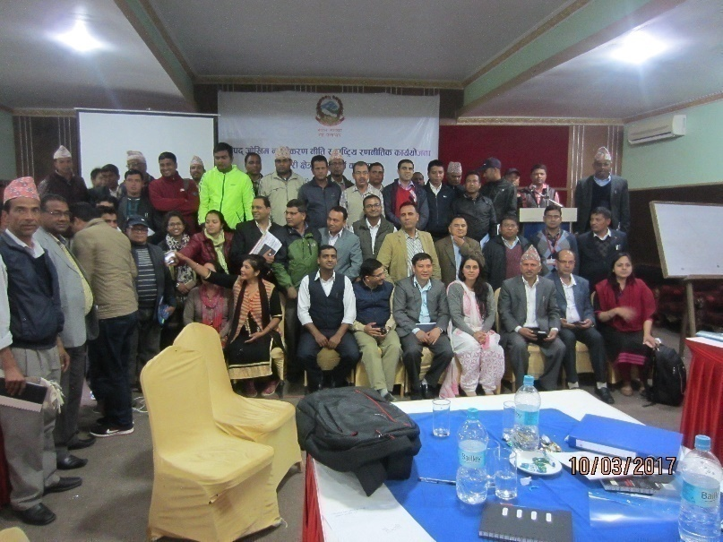
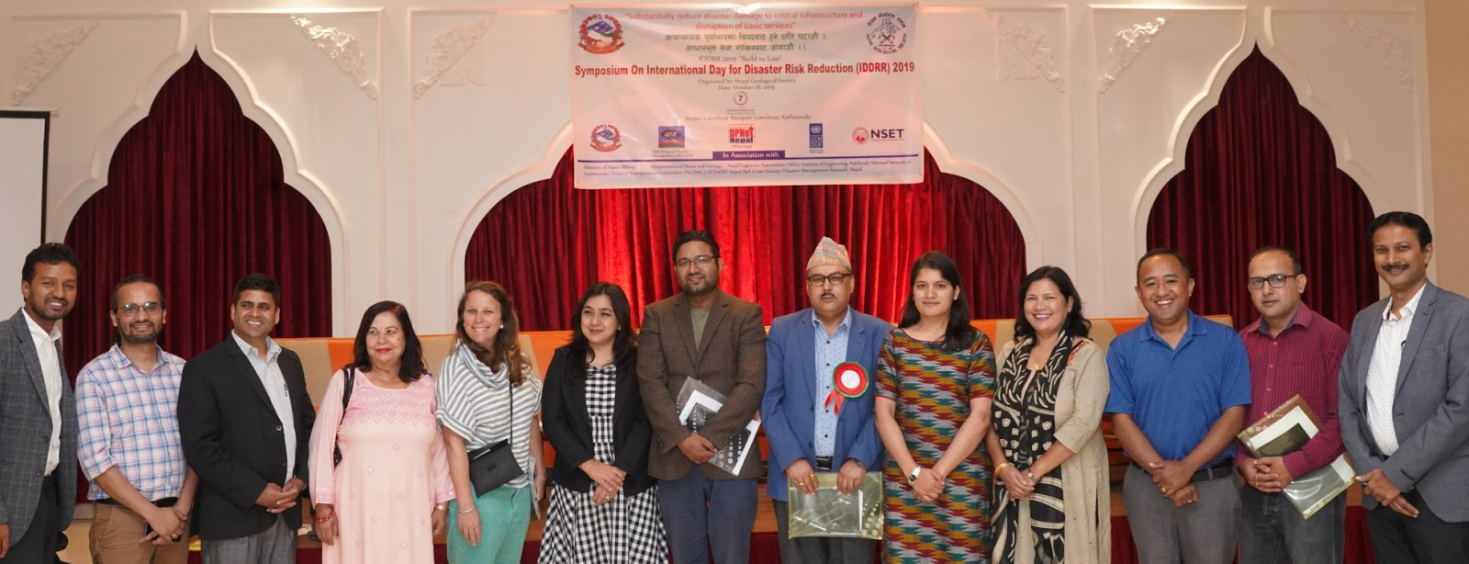
Focus area and Actions-1 Knowledge Management
Publication of Biennial Nepal Disaster Report since 2009, since 2019, it’s published by MoHA
Learning and sharing /policy dialogue
Establishment of Online Resource Centre in website.
Publication of IEC materials, including braille version and digital talking book of DRR&M related legal document.
Translation, Printing and Dissemination of SPHERE Handbook, Sendai Framework for DRR
Coordinate and lead for the celebration of National and International days

Slide 9
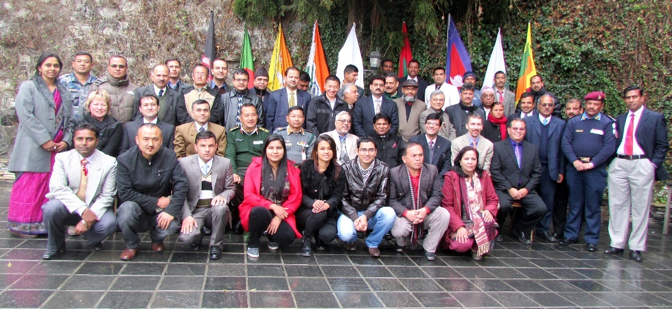
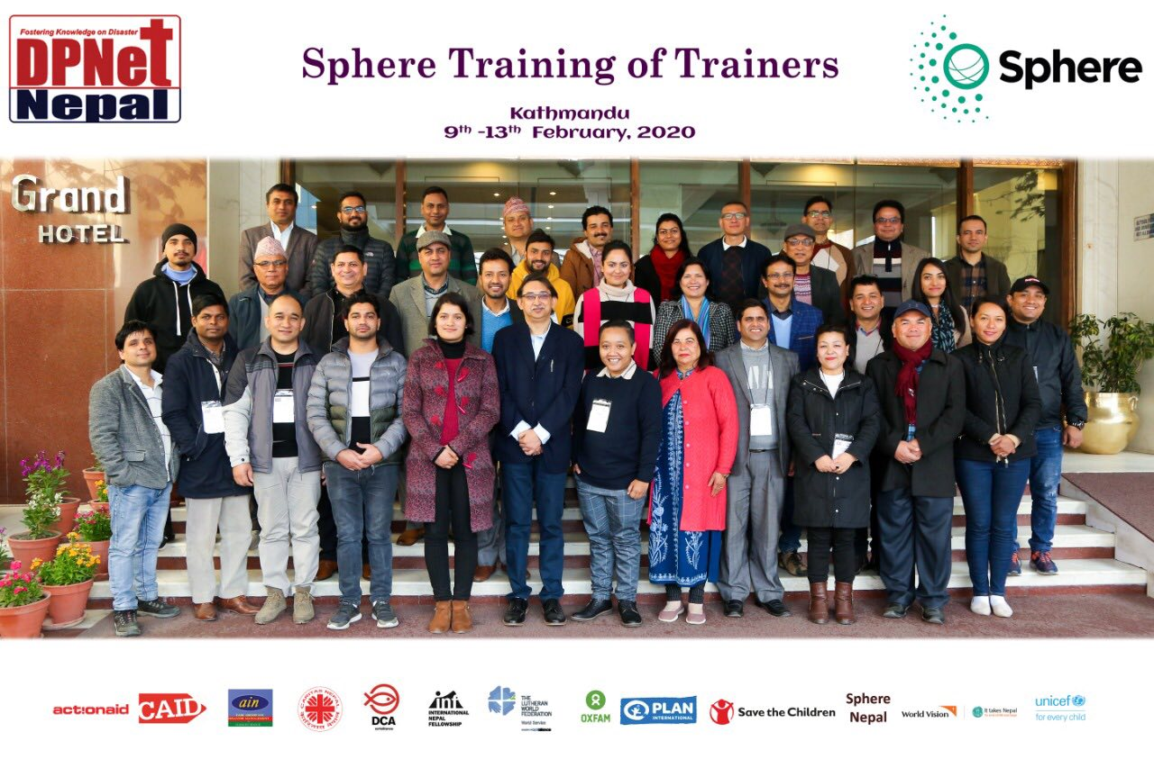
Focus area and actions-2 Capacity Building
DRM Training Program for Government Officials on Disaster Risk Management
Sphere ToT/trainings to representatives of Government and humanitarian agencies.
Development, maintenance and publication of roster of national and international DRR and CCA experts.
Participated in several South Asian level workshops and trainings on DRR
Organized regional level training on Incident Command System with SAARC-DMC and MoHA

Slide 10
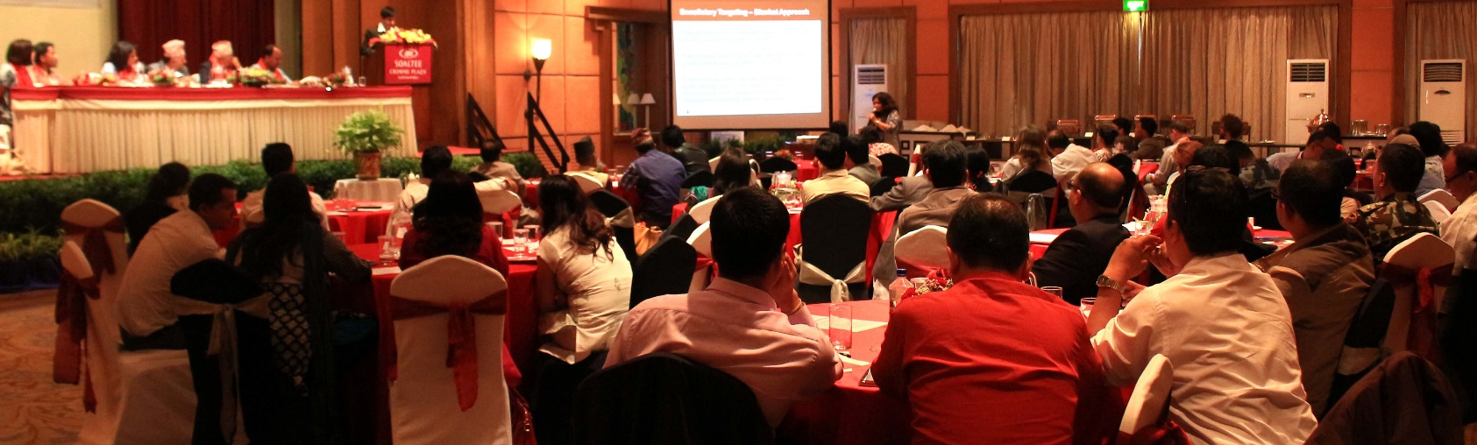
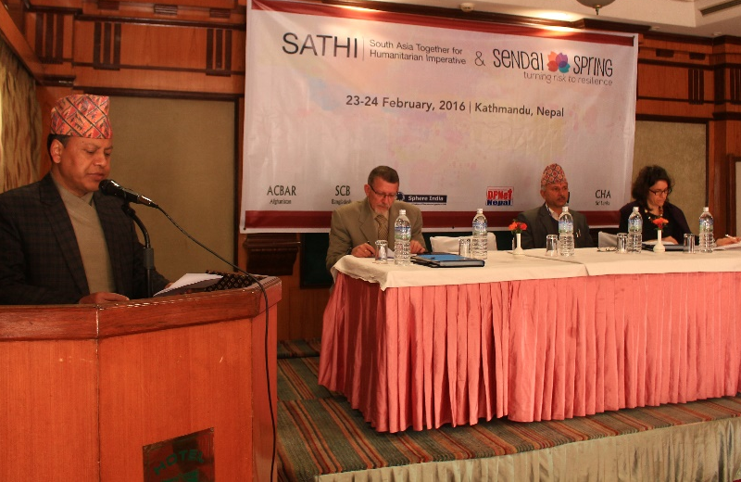
Focus area and actions-3
Coordination and Networking
Organizing meetings amongst Stakeholder Group and National Platform for DRR (NPDRR)
Bridging between GoN and civic society/humanitarian agencies
Partnership with local, national, regional and global Networks on Humanitarian Support and DRR for Quality and Accountability
Coordinates with stakeholders for the representation of Nepal in Asia Pacific Ministerial Conference on DRR and Global Platform for DRR
Regional networking- “South Asia Together for Humanitarian Imperative”

Slide 11
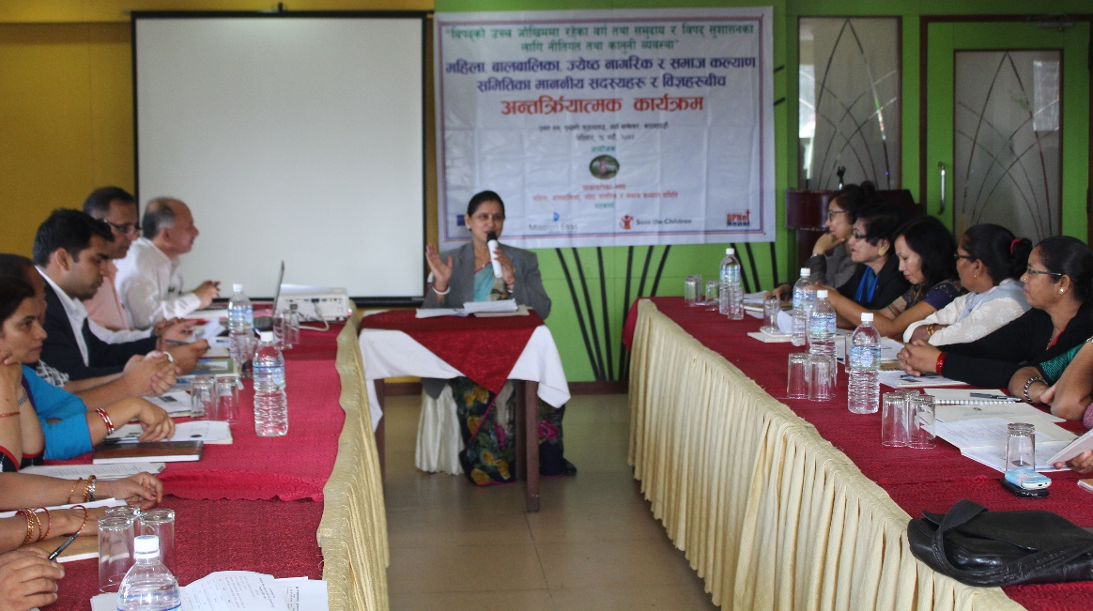
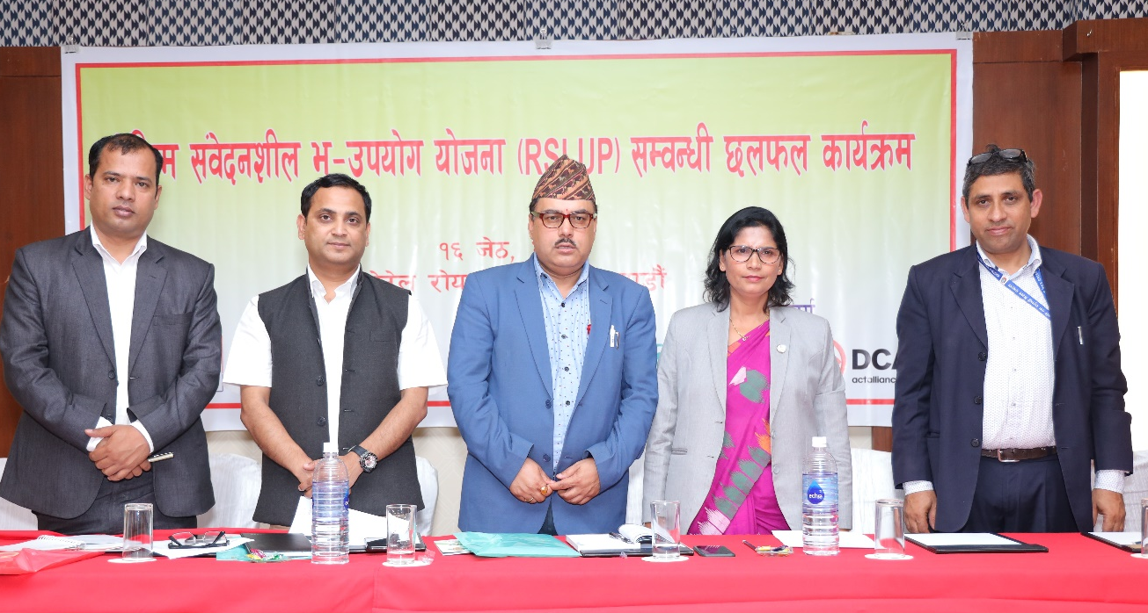
Focus area and actions-4 Policy Advocacy
Discussion, orientation and advocacy for the need of comprehensive Disaster Legislative framework with parliamentary committee
Technical support to develop DRR Policy and National Strategic Action Plan 2018-2030
Supported GoN to develop Disaster Preparedness and Response plan with Cluster Approach
Organization of dialogue meetings advocating Sendai Framework of Action and other key issues around DRR/CCA, Risk Sensitive Land Use Plan
Provide Feedback in DRR&M section of periodic plan and Media Partnership

Slide 12
Lessons Learned
Working as a bridge between Government and Non Government agencies has helped in better coordination and bringing wider stakeholders in single forum
Providing feedback and CSO’s perspective in draft legal documents has helped to include wider stakeholder’s perspective in DRR&M
Publication and sharing of IEC materials in different accessibility format has supported in inclusive knowledge management
Interaction programs with Members of Parliament and other Stakeholders has supported in the cause of Policy Advocacy

Slide 13
Key issues and Challenges
Understanding level of urban resilience (physical, social, ecconomical, cultural and environmental) is poor among the stakeholders
Policy implementation is slow and poor (NUDS, 2017, DRRM policies and Guidelines as state structuring is new in Nepal)
Governance and Accountability mechanism- particularly focusing to urban resilience, disaster, climate change adaptation
Sector integration and institutional arrangement between the ministries and departments need to be strengthened such as urban planning and infrastructure development are supported by MoUD and urban governance and administration led by MoFAGA.

Slide 14

THANK YOU

