Slide 1
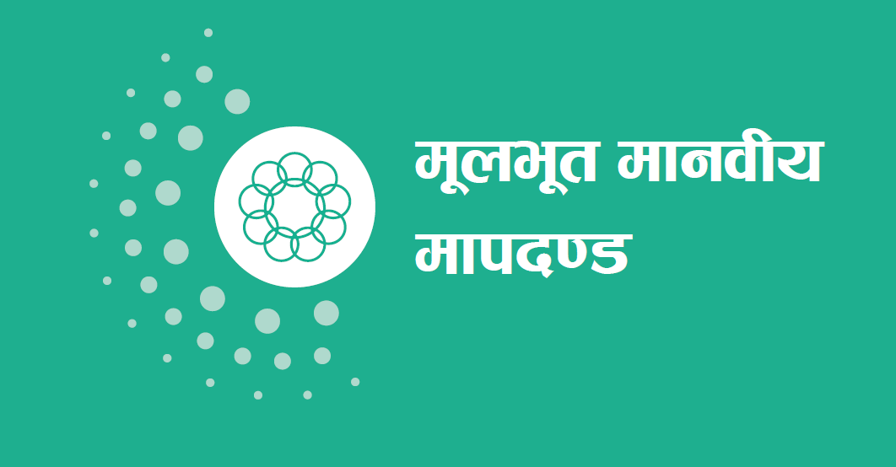
Core Humanitarian Standard

Slide 2
d'Vo ofb ug'{ kg]{ s'/f
d"ne"t dfgjLo dfkb08 (Core Humanitarian Standard – CHS on Quality and Accountability) eg]sf]
æk|lta4tfÆ (commitment)
æu'0f:t/Lo dfkb08Æ (quality criterion)

Slide 3
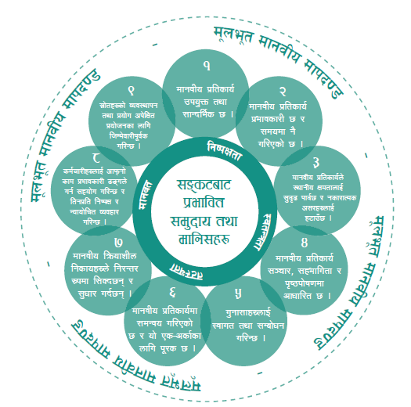

Slide 4
u'0f:t/ / hjfkmb]lxtf M k[i7e"ld, cfwf/e"t dfgjLo dfkb08, / o;sf] dxTj
s:n] k|of]u ug]{
d"ne"t dfgjLo dfkb08 To:tf ;ª\3;+:yf / JolQmx¿df nfu' x'G5, hf]—
ljkb\af6 k|efljt JolQm tyf ;d'bfox? nfO{ k|ToIf ;xof]u k|bfg ub{5 .
cGo ;+:yfx¿nfO{ cfly{s, ef}lts cyjf k|fljlws ;xof]u k|bfg ug{] t/ k|ToIf ¿kdf cfkm\gf] ;xeflutf ghgfpg]_ cyjf
oL b'j} nufotfsf tl/sfnfO{;Fu} ;d]6\g]
Notes:
Time: 9:45 – 10:30

Slide 5
d"ne"t dfgjLo dfkb08 (Core Humanitarian Standard – CHS)
;xof]usf] u'0f:t/ tyf k|efjsfl/tfdf ;'wf/ .
;ª\s6af6 k|efljt ;d'bfo tyf JolQm, sd{rf/L, bftf, ;/sf/ tyf cGo ;/f]sf/jfnfx¿ k|lt a9L hjfkmb]lxtf .
k|ltsfo{ tyf sfo{qmd — b'j}df / k|ltsfo{sf ;a} r/0fx¿df nfu" x'G5 .
JolQm tyf ;ª\u7g — b'j}sf nflu of] :j}lR5s 9fFrf (voluntary framework) xf] .

Slide 6
d"ne"t dfgjLo dfkb08 (Core Humanitarian Standard – CHS)
k|lta4tfdf ;ª\s6af6 k|efljt ;d'bfox¿ tyf dflg;x¿n] dfgjLo ;xof]u pknAw u/fpg] ;ª\u7g Pj+ JolQmx¿af6 s] ck]Iff ug{ ;Sb5g\ eGg] s'/f atfOPsf] 5 .
u'0f:t/;DaGwL dfkb08 (quality criterion) df To:tf] kl/l:yltsf] JofVof ul/G5 h'g kl/l:yltdf k|lta4tf k"/f ul/G5 / dfgjLo ;ª\u7g Pj+ sd{rf/Lx¿n] oL k|lta4tfx¿ k"/f ug{sf nflu s;/L sfd ug'{kb{5 eGg] klg atfOG5 .
sfo{;Dkfbgsf ;"rsx¿ (performance indicators) n] k|lta4tf k"/f ug]{ sfo{df ePsf] k|ultsf] dfkg ub{5g\, l;sfO tyf ;'wf/lt/ k|j[Q u/fpFb5g\ / ljleGg ;dodf tyf :yfgdf t'ngf ug{sf nflu cj;/ k|bfg ub{5g\ .

Slide 7
d"ne"t dfgjLo dfkb08 (Core Humanitarian Standard – CHS)
d'Vo lqmofsnfkx¿ (key action) tyf ;+:yfut lhDd]jf/Lx¿ (Organisational responsibilities) df sd{rf/Lx¿n] s] pknAw u/fpg'kb{5 / tL sd{rf/Lx¿n] pRr u'0f:t/sf] hjfkmb]lxtfk"0f{ dfgjLo ;xof]u pknAw u/fpgsf lgldQ ;ª\u7gx¿df s:tf gLlt, k|lqmof / k|0ffnLx¿ x'g' cfjZos x'G5 egL JofVof ul/Psf] 5 .
Dffu{bz{gsf nflu l6kf]6x¿ (guidance notes) n] pbfx/0fx¿ tyf yk hfgsf/L;lxt d'Vo lqmofsnfkx¿ tyf ;ª\u7gfTds lhDd]jf/Lx¿df ;xof]u pknAw u/fpFb5g\ .
dfu{bz{g ug]{ k|Zgx¿ (guiding questions) n] of]hgf th'{df, d"Nofª\sg tyf ultljlwx¿df ;xof]u pknAw u/fpFb5g\ .
;Gbe{ ;fdu|Lx¿ (references) df ljlzi6 ;jfnx¿sf af/]df yk l;sfO pknAw u/fOPsf] 5 .

Slide 8
k|lta4tf !
;ª\s6af6 k|efljt ;d'bfo / dflg;x¿n] cfk\mgf cfjZostfx¿sf nflu pko'Qm ;xof]u k|fKt u5{g\ .
u'0f:t/;DaGwL dfkb08
dfgjLo k|ltsfo{ pko'Qm tyf ;fGble{s 5 .

Slide 9
k|lta4tf !
sfo{;Dkfbgsf ;"rsx¿
!= k|ltsfo{df cfk\mgf ljlzi6 cfjZostf, ;+:s[lt tyf k|fyldstfx¿dfly Wofg lbOG5 egL ;ª\s6af6 k|efljt ;d'bfo / dflg;x¿n] ljrf/ ub{5g\ .
@= pknAw u/fOPsf ;xof]u tyf ;+/If0f n]vfhf]vf ul/Psf hf]lvd, ;ª\s6f;Ggtf tyf cfjZostfx¿;Fu d]n vfG5g\ .
#= k|ltsfo{df ;xof]u tyf ;+/If0f cfjZos ePsf dflg;x¿sf Ifdtf, ;Lk tyf 1fgdfly Wofg lbOG5 .

Slide 10
k|lta4tf @
;ª\s6af6 k|efljt ;d'bfo tyf JolQmx¿sf] kxF'r 7Ls ;dodf pgLx¿sf nflu cfjZos ePsf] dfgjLo ;xof]udf 5 .
u'0f:t/;DaGwL dfkb08
dfgjLo k|ltsfo{ k|efjsf/L 5 / ;dodf g} ul/Psf] 5 .

Slide 11
k|lta4tf @
sfo{;Dkfbgsf ;"rsx¿
!= Psbd} ;ª\s6f;Gg ;d"xx¿ nufot ;ª\s6af6 k|efljt dflg;x¿ cfk"mn] k|fKt u/]sf] ;+/If0f tyf ;xof]usf] ;do kof{Kt lyof] egL 7fGb5g\ .
@= k|ltsfo{af6 cfk\mgf cfjZostfx¿ k"/f ePsf 5g\ egL ;ª\s6af6 k|efljt ;d'bfo tyf dflg;x¿ 7fGb5g\ .
#= dfgjLo k|ltsfo{åf/f ;do, u'0f:t/ tyf kl/df0fsf b[li6af6 cfk\mgf p2]Zox¿sf] k"lt{ ePsf] 5 eGg] s'/f cg'udg tyf d"Nofª\sgn] b]vfpFb5g\ .

Slide 12
k|lta4tf #
;ª\s6af6 k|efljt ;d'bfo / dflg;x¿ dfgjLo lqmofsnfksf] kmn:j¿k gsf/fTds ¿kdf k|efljt 5}gg\ / tL ;d'bfo Pj+ dflg; a9L tof/L ePsf, pTyfgzLn tyf sd hf]lvddf 5g\ .
u'0f:t/;DaGwL dfkb08
dfgjLo k|ltsfo{n] :yfgLo IfdtfnfO{ ;'b[9 kfb{5 / gsf/fTds c;/x¿nfO{ x6fpF5 .

Slide 13
k|lta4tf #
sfo{;Dkfbgsf ;"rsx¿
!= dfgjLo lqmofsnfksf] kmn:j¿k efjL rf]6 tyf tgfjx¿ (future shocks and stresses) sf] ;fdgf ug{ cfk"m cem a9L /fd|/L ;Ifd ePsf 5f}F egL ;ª\s6af6 k|efljt ;d'bfo / dflg;x¿ 7fGb5g\ .
@= cfk\mgf] Ifdtfdf clej[l4 ePsf] 5 egL ;ª\s6x¿df k|ltsfo{ ug{] lhDd]jf/L ePsf :yfgLo clwsf/L, cu'jf tyf ;ª\u7gx¿ 7fGb5g\ .
#= ;ª\s6f;Gg tyf ;LdfGtLs[t JolQmx¿nufot ;ª\s6af6 k|efljt ;d'bfo / dflg;x¿n] dfgjLo lqmofsnfksf] kmn:j¿k s'g} klg gsf/fTds c;/x¿sf] klxrfg ub}{gg\ .

Slide 14
k|lta4tf $
;ª\s6af6 k|efljt ;d'bfo / dflg;x¿nfO{ cfk\mgf clwsf/ (rights) tyf xsbf/Lx¿ (entitlements) sf af/]df yfxf 5, hfgsf/Ldf ltgsf] kx'Fr 5 / cfk"mnfO{ c;/ ug]{ lg0f{ox¿df ltgn] efu lnG5g\ .
u'0f:t/;DaGwL dfkb08
dfgjLo k|ltsfo{ ;~rf/, ;xeflutf / k[i7kf]if0fdf cfwfl/t 5 .

Slide 15
k|lta4tf $
sfo{;Dkfbgsf ;"rsx¿
!= ;ª\s6af6 k|efljt ;d'bfo / dflg;x¿ cfk\mgf clwsf/ tyf xsbf/Lx¿k|lt ;r]t 5g\ .
@= ;ª\s6af6 k|efljt ;d'bfo / dflg;x¿n] cfk"mnfO{ yk hf]lvddf /fVg ;Sg] ;jfnx¿sf af/]df nufot :ki6 / ;fGble{s hfgsf/Lx¿df cfk\mgf] kx'Fr 5 eGg] 7fGb5g\ .
#= ;ª\s6af6 k|efljt ;d'bfo / dflg;x¿ k|ltsfo{dfly ePsf] pgLx¿sf] k|efjaf6 ;Gt'i6 5g\ .
$= k|efljt hg;ª\Vofsf clwsf/x¿sf af/]df ;Dk"0f{ sd{rf/Lx¿n] k|lzIf0f k|fKt u/]sf 5g\ / logsf af/]df pgLx¿nfO{ dfu{–bz{g pknAw u/fOPsf] 5 .

Slide 16
k|lta4tf %
;ª\s6af6 k|efljt ;d'bfo / dflg;x¿sf] kx'Fr u'gf;f]x¿dfly sf/afxL ug]{ ;'/lIft Pj+ ;Daf]wg ug]{ ;+oGqx¿df 5 .
u'0f:t/;DaGwL dfkb08
u'gf;fx¿nfO{ :jfut / ;Daf]wg ul/G5 .
(Complaint Response Mechanism CRM)

Slide 17
k|lta4tf %
sfo{;Dkfbgsf ;"rsx¿
!= ;ª\s6f;Gg tyf ;LdfGtLs[t ;d"xx¿nufot ;ª\s6af6 k|efljt ;d'bfo / dflg;x¿ cfk\mgf] k|of]usf nflu :yfkgf ul/Psf u'gf;f];DaGwL ;+oGqx¿sf af/]df ;r]t 5g\ .
@= u'gf;f]nfO{ ;Daf]wg ug]{ ;+oGqx¿ kx'Fr ug{ ;lsg], k|efjsf/L, uf]Ko tyf ;'/lIft 5g\ egL ;ª\s6af6 k|efljt ;d'bfo / dflg;x¿ 7fGb5g\ .
#= lgwf{l/t ;dofjlwleq u'gf;fx¿sf] cg';Gwfg ul/G5, ltgsf] ;dfwfg ul/G5 / To;sf lgisif{x¿sf af/]df u'gf;f] ug]{ JolQmnfO{ k[i7kf]if0f lbOG5 .

Slide 18
k|lta4tf ^
;ª\s6af6 k|efljt ;d'bfo / dflg;x¿n] ;dGjo ul/Psf], Ps–csf{sf nflu k"/s ;xof]u k|fKt ub{5g\ .
u'0f:t/;DaGwL dfkb08
dfgjLo k|ltsfo{df ;dGjo ul/Psf] 5 / of] Ps–csf{sf nflu k"/s 5 .

Slide 19
k|lta4tf ^
sfo{;Dkfbgsf ;"rsx¿
!= ;ª\u7gx¿n] ;dGjofTds lqmofsnfksf] dfWodaf6 k|efljt ;d'bfox¿ tyf ;fe]mbf/x¿åf/f klxrfg ul/Psf sdL–sdhf]/Lx¿ Pj+ cfk;df vlK6Psf s'/fx¿ (overlaps) sd kfb{5g\ .
@= :yfgLo ;ª\u7gx¿nufot k|ltsfo{df ;+nUg ;ª\u7gx¿n] ;dGjosf cf}krfl/s tyf cgf}krfl/s ;+oGqx¿sf] dfWodaf6 ;fGble{s hfgsf/Lx¿sf] cfbfg–k|bfg ub{5g\ .
#= ;ª\u7gx¿n] cfjZostfx¿sf] n]vfhf]vf, dfgjLo ;xof]u pknAw u/fpg] sfo{ tyf ;xof]usf] sfof{Gjogdf ;dGjo sfod ub{5g\ .
$= :yfgLo ;ª\u7gx¿n] ;dGjosf ;+oGqx¿df kof{Kt ;xeflutf tyf k|ltlglwTjsf af/]df l/kf]6{ ub{5g\ .

Slide 20
k|lta4tf &
ha ;ª\u7gx¿n] cg'ej tyf lrGtg–dggaf6 l;Sb} hfG5g\, ta ;ª\s6af6 k|efljt ;d'bfo tyf dflg;x¿n] ;'wfl/Psf] ;xof]u pknAw u/fpg] s'/fsf] ck]Iff ug{ ;Sb5g\ .
u'0f:t/;DaGwL dfkb08
dfgjLo lqmofzLn lgsfox¿n] lg/Gt/ ¿kdf l;Sb5g\ / ;'wf/ ub{5g\ .

Slide 21
k|lta4tf &
sfo{;Dkfbgsf ;"rsx¿
!= ;ª\s6af6 k|efljt ;d'bfo tyf dflg;x¿n] ;do laTb} hfFbf cfk"mn] k|fKt u/]sf ;xof]u tyf ;+/If0fdf ug'{kg]{ ;'wf/x¿sf] klxrfg ub{5g\ .
@= xfnsf] k|ltsfo{af6 pTkGg ePsf] l;sfOsf] kmn:j¿k ;xof]u tyf ;+/If0f;DaGwL sfo{qmdx¿df ;'wf/x¿ ul/Psf 5g\ .
#= pknAw u/fOPsf ;xof]u tyf ;+/If0fdf cGo k|ltsfo{x¿ af6 ul/Psf l;sfO k|ltlalDat 5g\ .

Slide 22
k|lta4tf *
;ª\s6af6 k|efljt ;d'bfo / dflg;x¿n] ;Ifd tyf /fd|f];Fu Joj:yfkg ul/Psf sd{rf/L tyf :jo+;]jsx¿af6 ;xof]u k|fKt ub{5g\ .
u'0f:t/;DaGwL dfkb08
sd{rf/Lx¿nfO{ cfk\mgf] sfd k|efjsf/L 9ª\un] ug{ ;xof]u ul/G5 / ltgk|lt lgikIf tyf Gofof]lrt Jojxf/ ul/G5 .

Slide 23
k|lta4tf *
sfo{;Dkfbgsf ;"rsx¿
!= ;Dk"0f{ sd{rf/Lx¿n] cfkmgf] sfddf ;ª\u7gåf/f ;xof]u kfPsf] dx;'; ub{5g\ .
@= sd{rf/Lx¿n] ;Gt'li6k"j{s sfo{;Dkfbg;DaGwL cfk\mgf p2]Zox¿ k"/f ub{5g\ .
#= ;ª\s6af6 k|efljt ;d'bfo / dflg;x¿n] sd{rf/Lx¿sf] 1fg, ;Lk, Jojxf/ tyf dgf]j[lQx¿sf b[li6af6 k|efjsf/L egL sd{rf/Lx¿sf] n]vfhf]vf ub{5g\ .
$= ;ª\s6af6 k|efljt ;d'bfo / dflg;x¿ dfgjLo cfrf/;+lxtfk|lt / ltgsf] pNnª\3gx¿sf af/]df ;/f]sf/x¿nfO{ s;/L p7fpg] eGg]af/]df ;r]t 5g\ .

Slide 24
k|lta4tf (
;ª\s6af6 k|efljt ;d'bfo / dflg;x¿n] cfk"mnfO{ ;xof]u ul//x]sf ;ª\u7gx¿n] ;|f]tx¿sf] Joj:yfkg k|efjsf/L ¿kdf, bIftfk"j{s / g}ltstfk"j{s ul//x]sf 5g\ egL ck]Iff ug{ ;Sb5g\ .
u'0f:t/;DaGwL dfkb08
;|f]tx¿sf] Joj:yfkg tyf k|of]u ck]lIft k|of]hgsf nflu lhDd]jf/Lk"j{s ul/G5 .

Slide 25
k|lta4tf (
sfo{;Dkfbgsf ;"rsx¿
!= ;ª\s6af6 k|efljt ;d'bfo / dflg;x¿ ;d'bfosf] txsf ah]6, vr{ / xfl;n ul/Psf glthfx¿sf af/]df ;r]t 5g\ .
@= ;ª\s6af6 k|efljt ;d'bfo / dflg;x¿n] pknAw ;|f]tx¿sf] k|of]u eO/x]sf] 5 eGg] 7fGb5g\ M s= tL s'g k|of]hgx¿sf nflu lyP, / v= ltgsf] ckrng ul/Psf] 5}g cyjf tL v]/ kmflnPsf 5}gg\ .
#= k|ltsfo{sf nflu k|fKt ul/Psf ;|f]tx¿sf] k|of]u dGh'/ ul/Psf of]hgf, nIo, ah]6 / ;do;Ldfadf]lhd ul/Psf] 5 / ltgsf] cg'udg ul/Psf] 5 .
$= nfutsf t'ngfdf a9L k|ltkmn k|fKt x'g] u/L dfgjLo k|ltsfo{ pknAw u/fOPsf] 5 .

Slide 26
wGojfb

